Slide 1
Advanced Data Analysis Joining Time Series
Emanuele Della Valle
Prof. @ Politecnico di Milano
Founder & Partner @ Quantia Consulting
Marco Balduini
Founder & CEO @ Quantia Consultin
Riccardo Tommasini
Prof. @ University of Tartu

Slide 2
Exploring Flux Joining Time Series

Slide 3
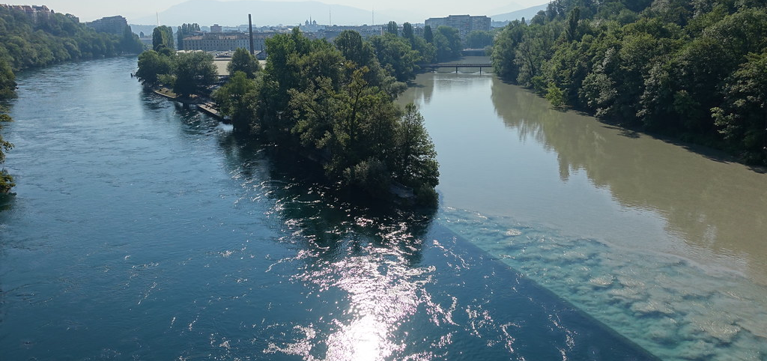
Joining two time series

Slide 4
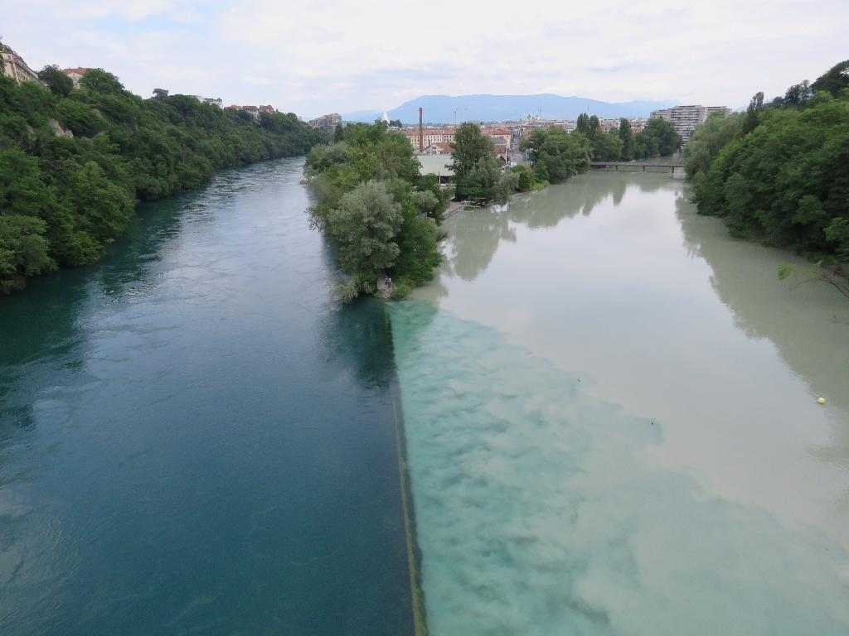
The ideal case

Slide 5
Running example on pizza quality issues
If the temperature difference between the base cooking area and the mozzarella melting area is lower than 180° or greater than 190°, the mozzarella cheese will not melt properly or it will burn.

Slide 6
Ok … sounds easy
305
290
285
S1
280
280
00:00
01:00
02:00
03:00
04:00
120
105
110
S2
100
95
00:00
01:00
02:00
03:00
04:00
S1-S2
185
185
185
185
170
00:00
01:00
02:00
03:00
04:00

Slide 7
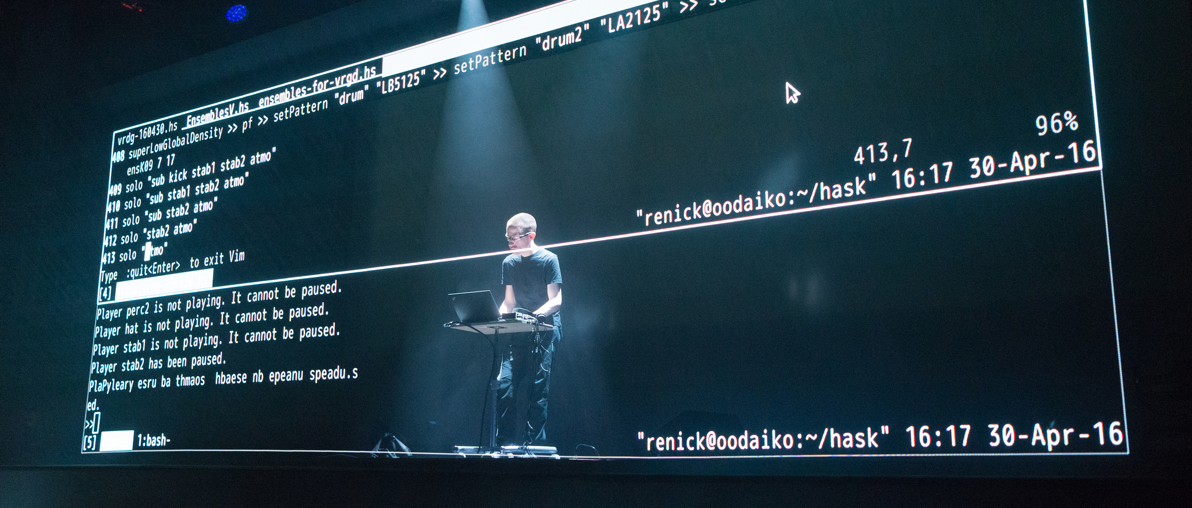
Let’s do some live coding

Slide 8
Here we go
ts12 = from(bucket: "training")
|> range(start: 2020-06-07T12:00:00Z, stop: 2020-06-07T12:05:00Z)
|> filter(fn: (r) => r._measurement == "iot-oven")
|> filter(fn: (r) => r._field == "temperature")
ts1 = ts12 |> filter(fn: (r) => r.sensor == "S1")
ts2 = ts12 |> filter(fn: (r) => r.sensor == "S2")
join(tables: {key1: ts1, key2: ts2}, on: ["_time"], method: "inner")
join |> map(fn: (r) => ({ _time: r._time,
_value: r._value_s1 - r._value_s2 }))

Slide 9
It gives no results … why?
:-/

Slide 10
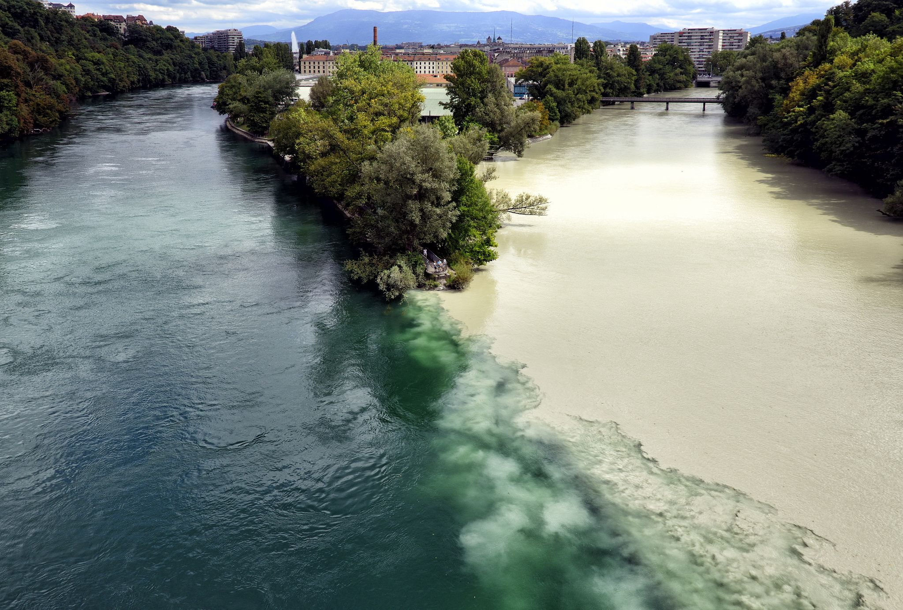
The reality is always more difficult than expected

Slide 11
A close look to the distribution of our data over time
305
290
285
S1
280
280
00:00
01:00
02:00
03:00
04:00
120
115
115
105
110
110
S2
100
95
90
00:15
00:45
01:15
01:45
02:15
02:45
03:15
03:45
04:15
NOTE: S1 and S2 are not synchronized: metrics don’t occur at the same time and rate
Notes:
Time shift
ma ci sono riuscito solo perchè potevo ispezionare I dati
trunchiamo?
Valori multipli|!!!
E allora?
aggregate window

Slide 12
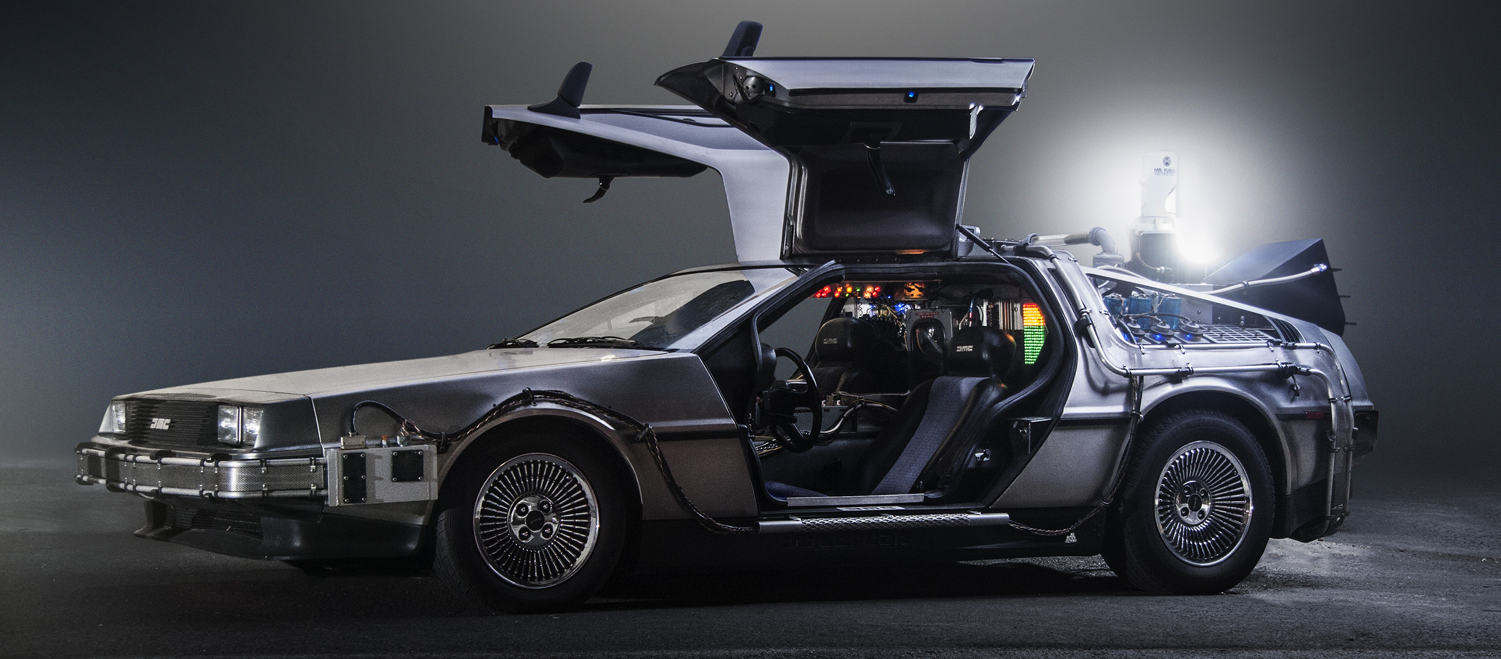
Can we synchronize them? Let’s do a time shift!

Slide 13
Can we synchronize them with a time shift?
305
290
285
S1
280
280
00:00
01:00
02:00
03:00
04:00
120
115
115
105
110
110
S2
-15 sec
100
95
90
00:15
00:45
01:15
01:45
02:15
02:45
03:15
03:45
04:15

Slide 14
Here we go
temp = from(bucket: "training")
|> range(start: v.timeRangeStart, stop: v.timeRangeStop)
|> filter(fn: (r) => r._measurement == "iot-oven")
|> filter(fn: (r) => r._field == "temperature")
tempS1 = temp |> filter(fn: (r) => r.sensor == "S1")
tempS2 = temp |> filter(fn: (r) => r.sensor == "S2")
|> timeShift(duration: 15s, columns: ["_time"] )
temp_join = join( tables: {s1:tempS1, s2: tempS2}, on: ["_time"] )
temp_join |> map(fn: (r) => ({ _time: r._time,
_value: r._value_s1 - r._value_s2 }))

Slide 15
Can we synchronize them with a time shift?
305
290
285
S1
280
280
00:00
01:00
02:00
03:00
04:00
120
115
115
105
110
110
S2
100
-15 sec
95
90
00:00
00:30
01:00
01:30
02:00
02:30
03:00
03:30
04:00
NOTE: some metrics now occur at the same time, but the rate is still different

Slide 16
Moreover, is -15 sec correct? Shall I do -30 sec, instead?
:-/

Slide 17

Shall we tumble?

Slide 18
Can we synchronize them with a tumbling window?
305
290
285
S1
280
280
00:00
01:00
02:00
03:00
04:00
120
115
115
105
110
110
S2
100
95
90
00:15
00:45
01:15
01:45
02:15
02:45
03:15
03:45
04:15
NOTE: S1 and S2 are not synchronized: metrics do not occur nor at the same to nor rate

Slide 19
Can we synchronize them with a tumbling window?
305
290
285
S1
280
280
00:00
01:00
02:00
03:00
04:00
120
115
115
105
110
110
S2
100
95
90
00:15
00:45
01:15
01:45
02:15
02:45
03:15
03:45
04:15
NOTE: S1 and S2 are not synchronized: metrics do not occur nor at the same to nor rate

Slide 20
Can we synchronize them with a tumbling window?
305
290
285
S1
280
280
00:00
01:00
02:00
03:00
04:00
120
115
115
105
110
110
S2
100
95
90
00:15
00:45
01:15
01:45
02:15
02:45
03:15
03:45
04:15
NOTE: S1 and S2 are not synchronized: metrics do not occur nor at the same to nor rate

Slide 21
Here we go
temp = from(bucket: "training")
|> range(start: 2020-04-30T10:00:00Z, stop: 2020-04-30T10:05:00Z)
|> filter(fn: (r) => r._measurement == "iot-oven")
|> filter(fn: (r) => r._field == "temperature")
tempS1 = temp |> filter(fn: (r) => r.sensor == "S1")
|> aggregateWindow(every: 60s, fn: mean)
tempS2 = temp |> filter(fn: (r) => r.sensor == "S2")
|> aggregateWindow(every: 60s, fn: mean)
temp_join = join( tables: {s1:tempS1, s2: tempS2}, on: ["_time"] )
temp_join |> map(fn: (r) => ({ _time: r._time,
_value: r._value_s1 - r._value_s2 }))

Slide 22
It works!
:-)

Slide 23
Bonus point: tumbling windows also synchronize events!
305
290
285
S1
280
280
00:09
01:06
02:04
03:02
04:07
120
115
115
105
110
110
S2
100
95
90
00:12
00:46
01:21
01:39
02:17
02:36
03:16
03:48
04:18
MENO: events are irregular time series

Slide 24
Bonus point: tumbling windows also synchronize events!
305
290
285
S1
280
280
00:09
01:06
02:04
03:02
04:07
120
115
115
105
110
110
S2
100
95
90
00:12
00:46
01:21
01:39
02:17
02:36
03:16
03:48
04:18
MENO: events are irregular time series

Slide 25
Bonus point: tumbling windows also synchronize events!
305
290
285
S1
280
280
00:09
01:06
02:04
03:02
04:07
120
115
115
105
110
110
S2
100
95
90
00:12
00:46
01:21
01:39
02:17
02:36
03:16
03:48
04:18
MEMO: events are irregular time series

Slide 26
Quiz
Which synchronization method shall you use before joining? none | timeShift | aggregateWindow
one timeseries is regular, but the other is not - ?
two timeseries are regular, have the same rate, but metrics occur at a different time - ?
two timeseries are regular, have the same rate, and metrics occur at the same time - ?
two timeseries are irregular - ?
two timeseries are regular, but metrics don't occur at the same time and rate - ?

Slide 27
Quiz answers
Which synchronization method shall you use before joining? none | timeShift | aggregateWindow
one timeseries is regular, but the other is not - aggregateWindow
two timeseries are regular, have the same rate, but metrics occur at a different time - timeShift
two timeseries are regular, have the same rate, and metrics occur at the same time - none
two timeseries are irregular - aggregateWindow
two timeseries are regular, but metrics don't occur at the same time and rate - aggregateWindow

Slide 28

Let’s get dirty!
8

Slide 29
Continuous Linear Pizza Oven
Learning goals:
Join data
s2
s1

Slide 30
Task
Extract the difference between the humidity levels of the base cooking area and the mozzarella melting area. Find if the differences are lower than 20% or greater than 30%

Slide 31
Advanced Data Analysis Joining Time Series
Emanuele Della Valle Prof. @ Politecnico di Milano & Partner @ Quantia Consulting
Marco Balduini Founder & CEO @ Quantia Consulting
Riccardo Tommasini Prof. @ University of Tartu

